Slide 1
Grizzly Mobile
Christian Ndaye
Michael Anthony
Adam Moritz

Slide 2

Citrus

Slide 3
Citrus
Is a mobile Application that will operate with cheap, environmentally conscientious transportation, electric bikes and scooter.

Slide 4
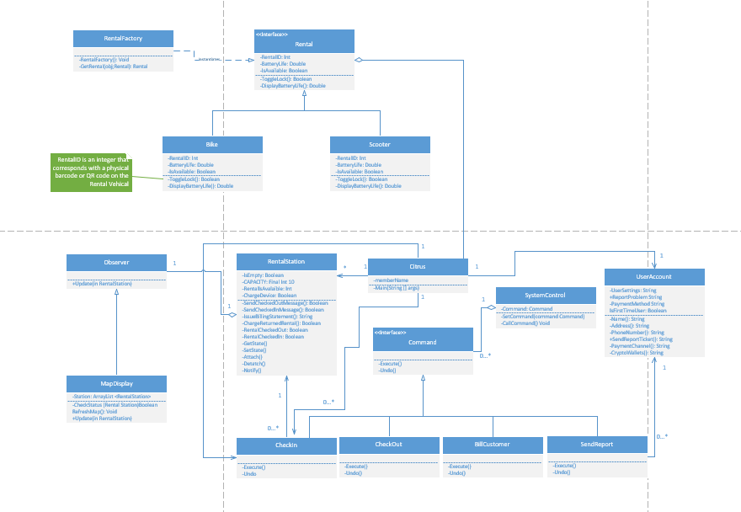
Citrus UML Diagram

Slide 5
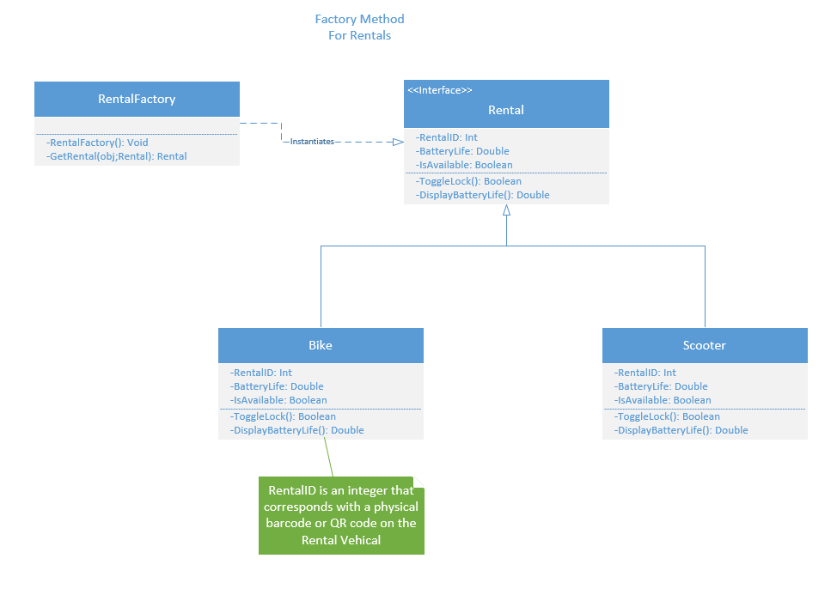
Factory Diagram

Slide 6
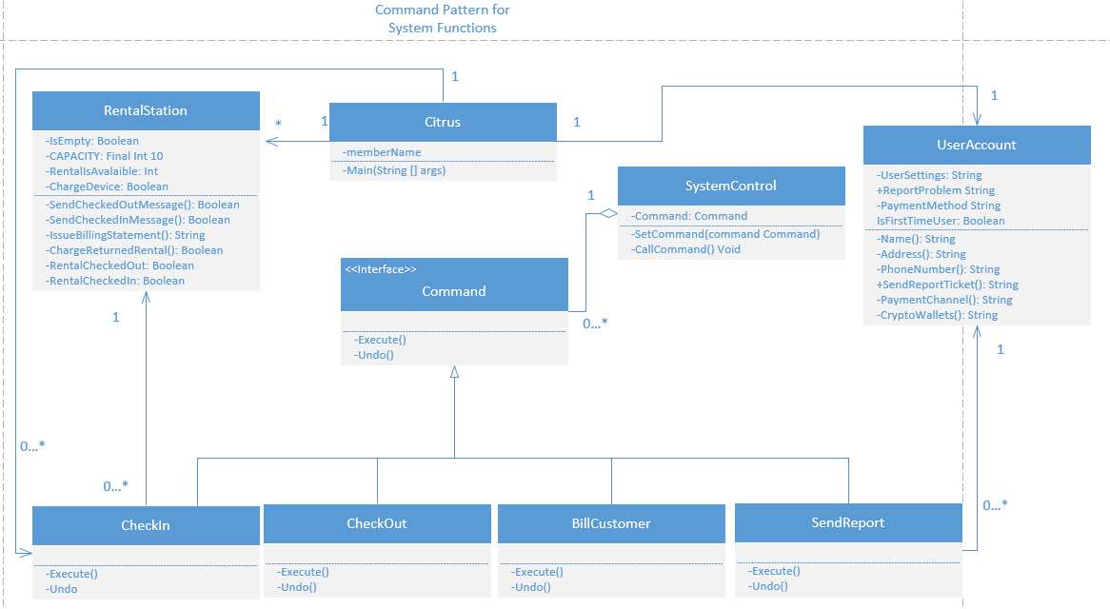
Command Diagram

Slide 7
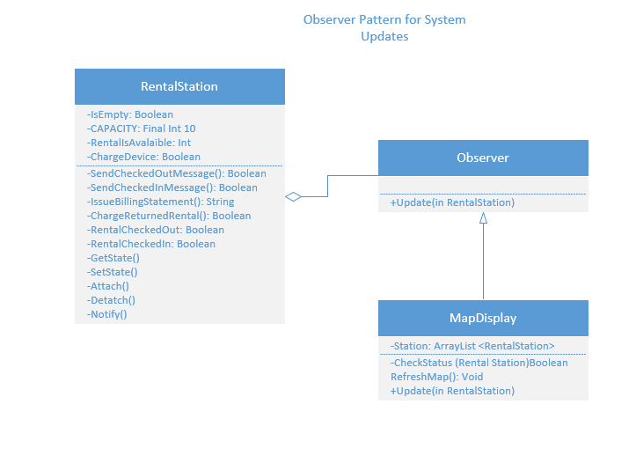
Observer Diagram

Slide 8
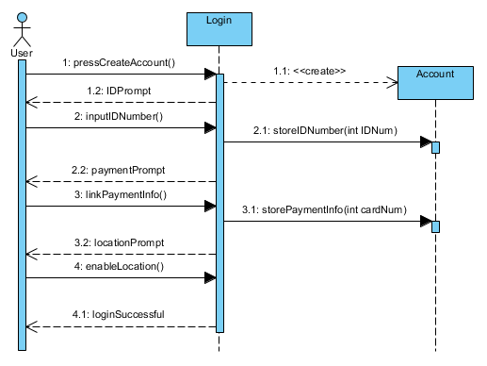
Sequence Diagram 1

Slide 9
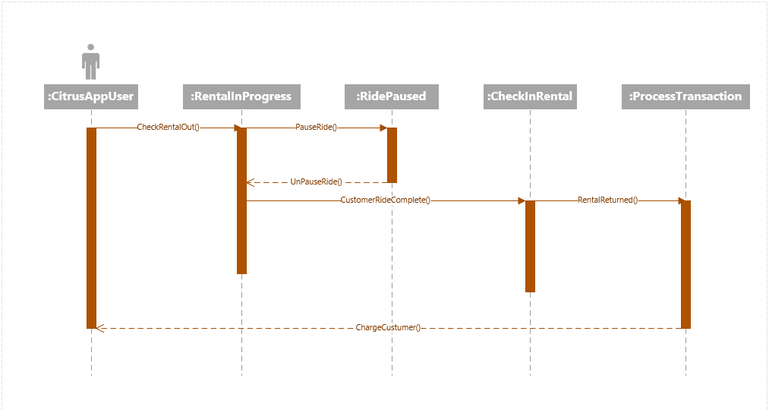
Sequence Diagram 2

Slide 10
Thanks!
Contact us:
Grizzly Mobile
Christian Ndaye
chndaye@ursinus.edu
Michael Anthony
mianthony@ursinus.edu
Adam Moritz
admoritz@ursinus.edu

